Slide 1

Crime Rate VS House Price ANALYSIS

Slide 2
Hypotheses:
Crime rate will affect the house price negatively. The higher the crime rate in the suburb, the less likely the house price will increase

Slide 3

Key Step for the analysis
Looking at historical data first
Obtain the sold property in all Melbourne Region to 2016-2018
Determining the factors that will affect the house price, and search for relevant dataset.
The neighborhood quality and amenities impact
Set up hypotheses
Dig deep into the factors by analyzing the data that we have
Fine tune the analysis to find the correlation between the factors

Slide 4
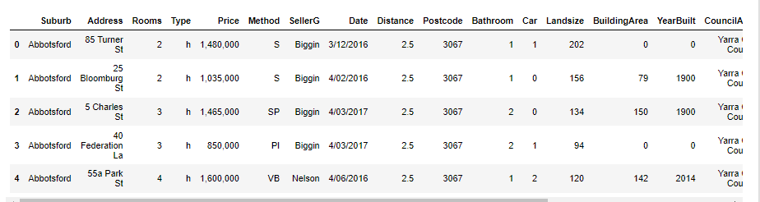
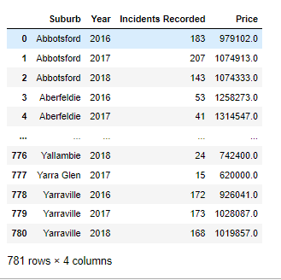
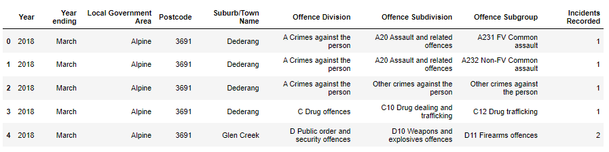
Data Cleaning
Group by (aggregate method) to see the summary results
Drop unwanted columns to make my readings easier
Crime dataset- initial we have >100k rows and 9 columns
Final dataset has only 3 columns
Merge both data frames
Rename column name – easier to recognise
Housing data – changing the datatype of the sales price – from object to float

Slide 5
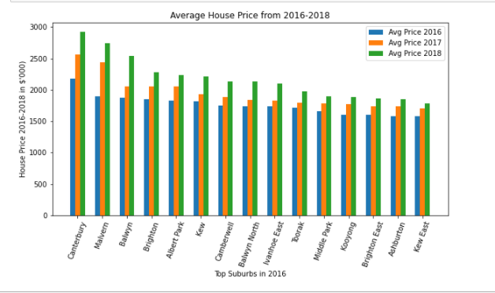

Look at the Past market trends
Top Suburbs house prices trend

Slide 6
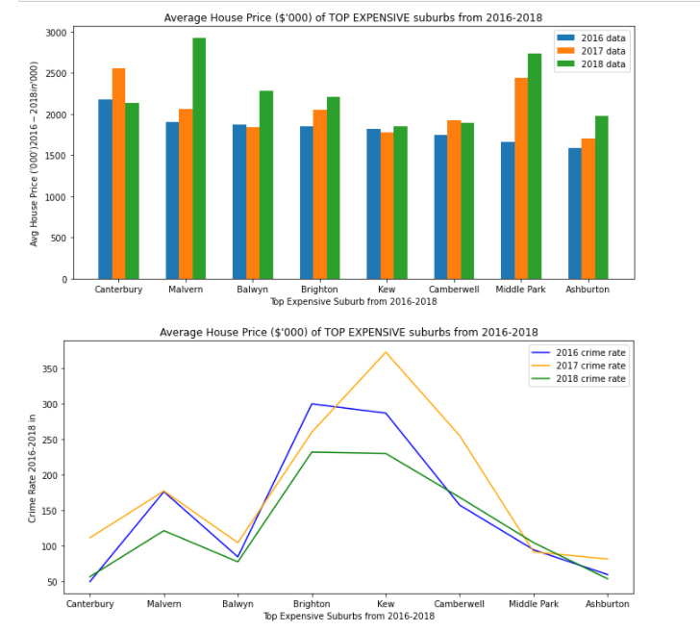
Evidence of Data Exploration
Select the top expensive suburbs from 2016-2018
Find out the crime rate (2016-2018) for the selected suburbs

Slide 7
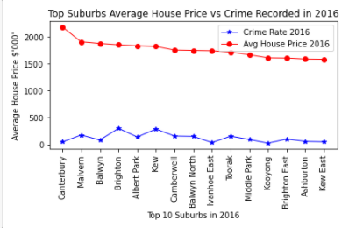
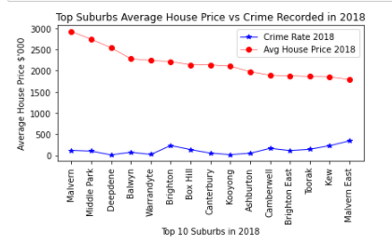
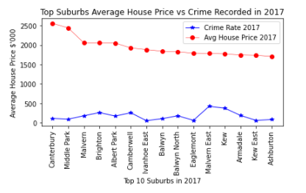
Deep Dive – The top expensive suburbs for each year How does the crime rate look like?
The most expensive suburbs that will have lower crime rate?
Seems like some less expensive suburbs also have low crime rate….

Slide 8
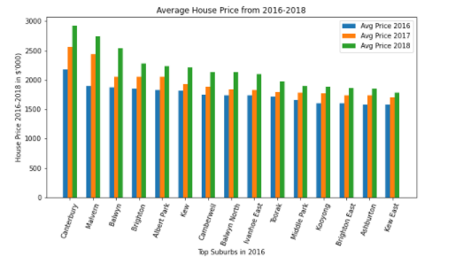
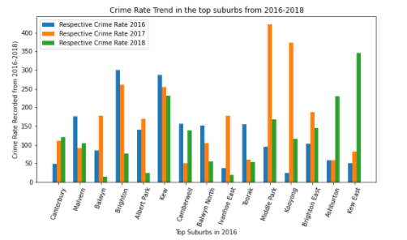
Narrowing down… Only selecting the top suburbs in 2016 to see the trend over the years

Slide 9
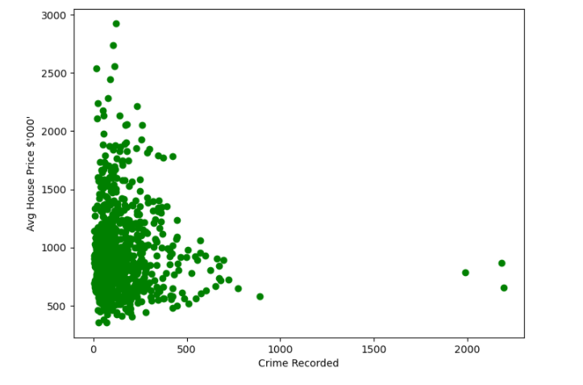
Evidence of Data Exploration Scatter plot
We have paired numerical data
Trying to find out if the two variables are related
For this instance, trying to find out if CRIME RATE is the potential cause of the rise of house price?
Crime rate vs Avg House Price (by the suburbs)
(2016 – 2018)

Slide 10
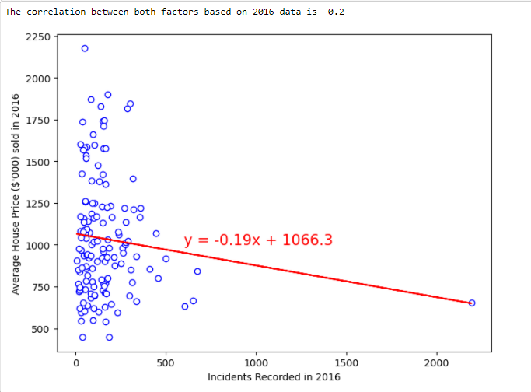
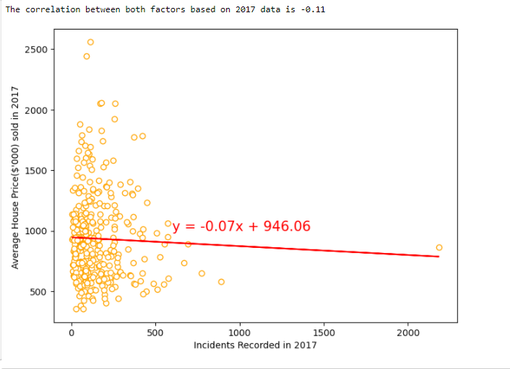
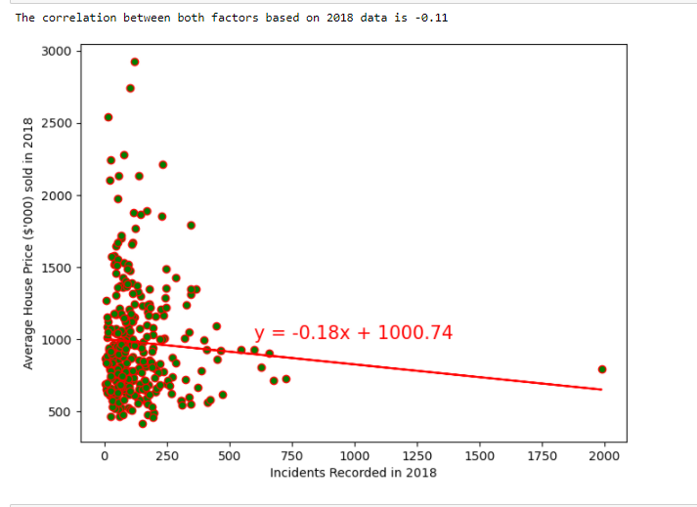
Data Exploration Scatter plot for each year
Crime rate vs Avg House Price (by the suburbs)
- Negative correlation…?

Slide 11
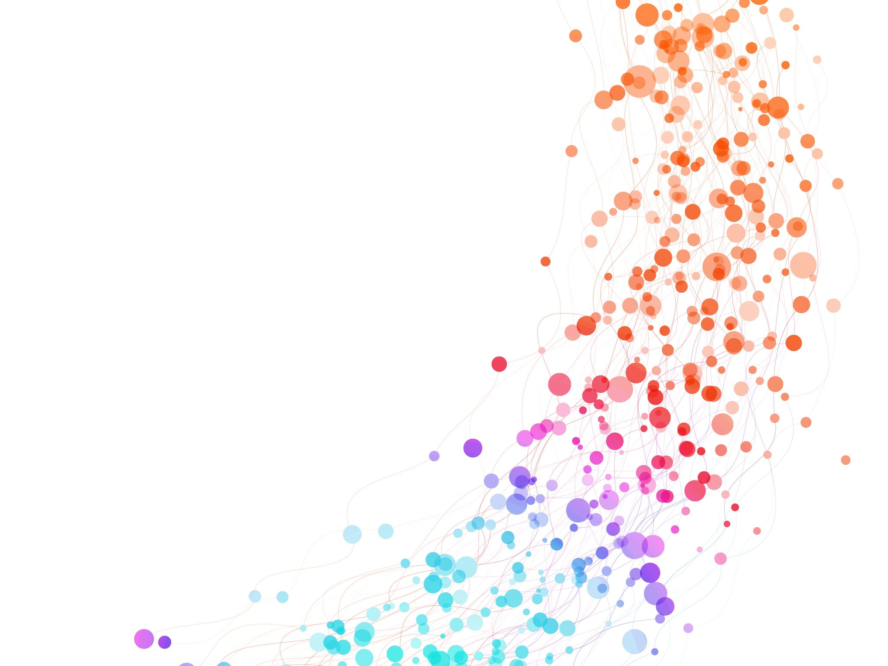
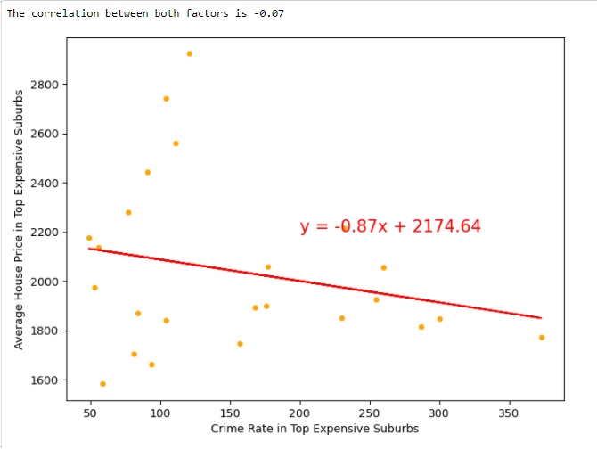
Correlation Analysis for Top Expensive Suburbs
Negative correlation between the two factors

Slide 12
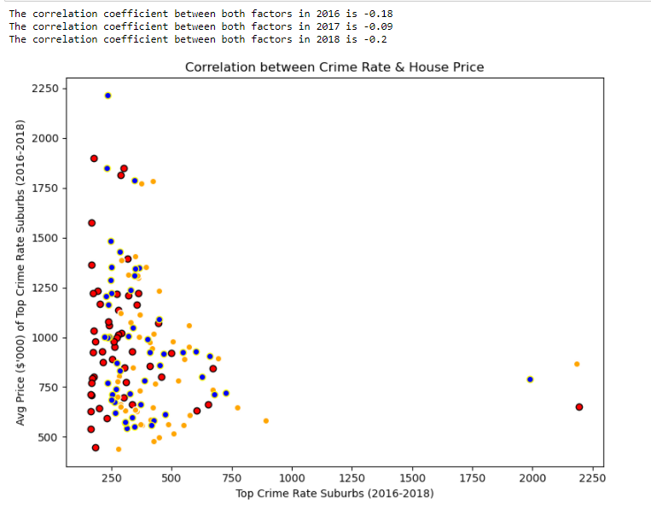
Correlation Analysis for Top Crime Rate Suburbs
Top crime rate suburbs for each year, with their average house price
It seems like there’s a negative correlation between both factors

Slide 13
Summary of findings
Overall data exploration by each year
Top expensive suburbs vs Crime rate– by each year
Top crime rate suburbs vs House Price – by each year
Back to Hypotheses:
Crime rate will affect the house price negatively.
This proves that the hypotheses is correct
Positive house price trend
Crime rate varies for each year
Negative correlation
Negative correlation

